Slide 1
SOCIAL MEDIA POST TEMPLATE
Questel, July 2021

Slide 2
Social Media
Reminder: Questel’s social media accounts
@Questel
@Questel
@Questel_Group

Slide 3
Social Media Trendy Hashtags (IP sector)
Social Media
 | Twitter | Linkedin | Youtube
 | #B2B | #Knowledge | #IntellectualProperty
 | #Infographic | #lntellectualProperty | #IP
 | #IntellectualProperty | #IP | #IPrights
 | #Patent | #Software | #Patent
 | #Innovative | #Patent | #Trademark
 | #IP | #IPstrategy | #Copyright
 | #Software | #IntellectualPropertyLaw | #Tradesecrets

Slide 4
@Questel

Slide 5
Linkedin - Goals
Social Media
① Notoriety
Tips : ​
Use stories with @Tag and #Hashtags in the morning, before 10am​
Share a story the day of the webinar​
Use #Hashtags directly in the text​
Always @Tag people
​
Warning: ​
​
1300-criteria maximum​
​
5 #Hashtags maximum
Improve notoriety and visibility in order to increase the number of subscribers and to sensitize people to IP.
② Conversion
Share content from the website (press releases, resources hub, webinars…) in order to attract website users.
③ Attraction
Post regularly on various topics (events, webinars, employees, stakeholders...) to communicate regularly and thus attract web user followers.

Slide 6
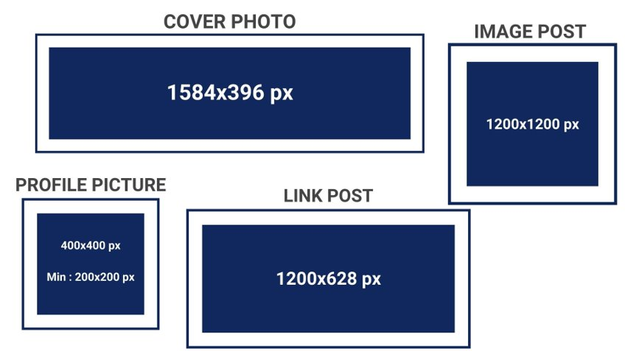
Linkedin – Picture size
Social Media

Slide 7
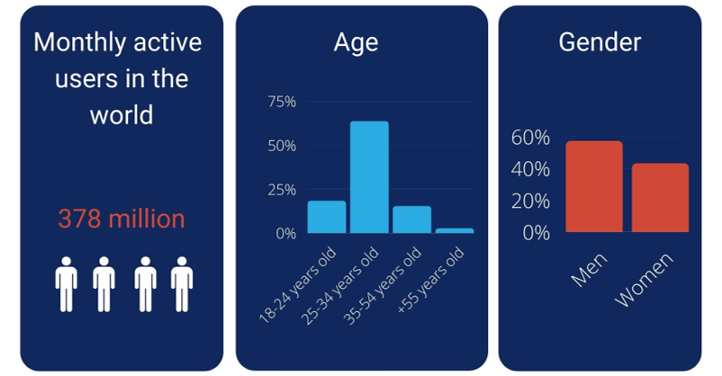
Linkedin – Audience
Social Media
Source: blog.digimind.com​

Slide 8
@Questel_group

Slide 9
Twitter - Goals
Social Media
① Notoriety & competition monitoring
Warning: ​
280-criteria limit​
2 to 6 #Hashtags maximum
Always @Tag people​
Tips: use #Hastags directly in the text
Improve notoriety and visibility and increase the number of subscribers by:
Communicating frequently
Retweeting
Sharing information
Conducting competition monitoring.
② Attraction & sharing news
Post regularly on various topics (events, webinars, employees, stakeholders...) and share news to communicate regularly to attract and retain web user followers.
③ Improving visibility
Share our brand image, create virality and be up to date on real-time information.

Slide 10
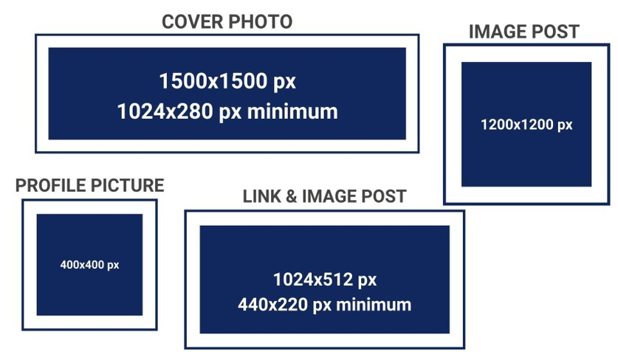
Twitter – Picture size
Social Media

Slide 11
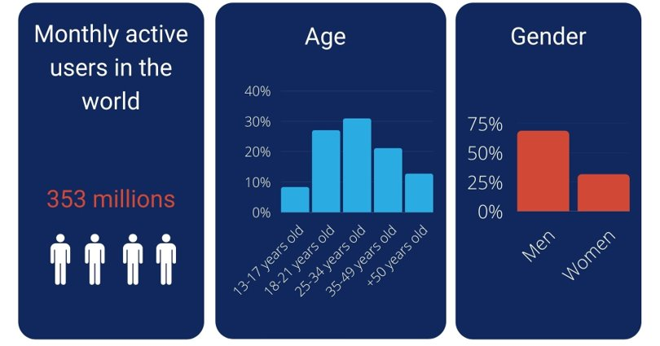
Twitter – Audience
Social Media
Source: blog.digimind.com /
Statista.com​​

Slide 12
@Questel

Slide 13
Youtube - Goals
Social Media
① Visibility
Tips:
Create playlists with attractive titles for each type of video/interview
The thumbnail is especially important
Improve our visibility by sharing interviews of stakeholders, tips, webinars and by posting new content on the social platform.
② Proximity
Post interviews to communicate and share about life at Questel and the feedback of all stakeholders (investors, employees, clients, board members...).

Slide 14
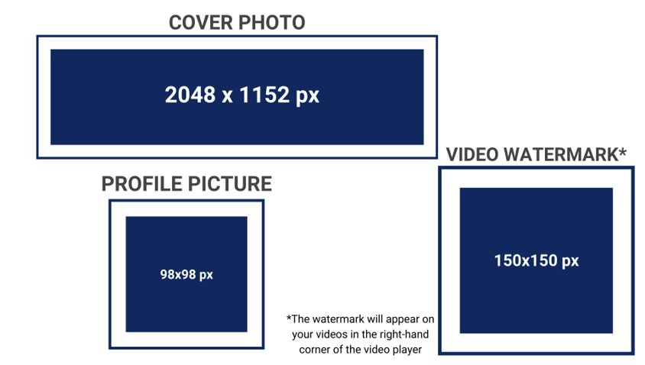
Youtube – Picture Size
Social Media

Slide 15
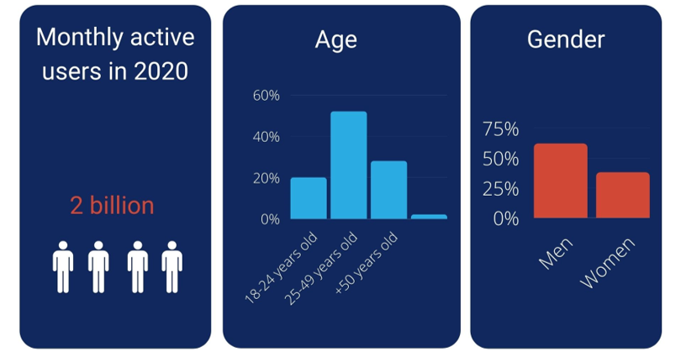
Youtube - Audience
Social Media
Source: blog.hubspot.fr / powertrafic.fr​

Slide 16
Social Media
Ambitions and ideas :
Simple and uncluttered visuals
Use mainly the 3 colours of Questel: navy (#10285d), brick (#d14836) and white (#ffffff) → Navy is the main colour
Alternate between colours when making several posts on the same theme (or in a slider)
Play with the first letter of the logo on infographics
Photos: ambient photos, distance shorts, with a "work" environment as background (office, workplace).
Highlight the essential sentences, shorten them if necessary

Slide 17
Social Media
Frequency
<
Several formats
1 to 2 posts / week
Rule : avoid making 2 posts on the same day to the extent possible!
Pictures
Infographics
Videos/interviews
Slider
Gif

Slide 18
As the first step toward respect
Speak to everyone in the same way and listen
#Courtesy

Slide 19
To try, to fail, and to try again
The Journey, rather than the success
#Courage

Slide 20
Know thyself
Honesty, with coworkers, partners and customers of course, but first with ourselves
#Honesty

Slide 21
9
Objectives
for 2025
#CSR

Slide 22
1
50% women in managers
#GenderEqualityIsAPriority

Slide 23
2
25% of our purchases are from local suppliers
#Sustainability

Slide 24
3
20% of new electronics are reconditioned
#TogetherForABetterWorld

Slide 25
4
10 partnerships
with major universities around the
world
#YouthIsTheFuture

Slide 26
5
-50%
of internal travel
CO2 emission
per employee
#PolluteLess

Slide 27
6
100% of our employees are trained and involved in our CSR strategy
#Commitment

Slide 28
7
50% of offices and servers run on green energy
#GreenChallenges

Slide 29
8
50% of our suppliers are compliant and join our CSR policies
#CSRIsInOurDNA

Slide 30
9
100% of our offices found hardware sustainable waste solutions
#SustainabilityForABetterFuture

Slide 31
incorporate in its strategy
The 10 principles
in 4 areas of the
UN Global Compact

Slide 32
1
Human
Rights
#SupportAndRespect

Slide 33
2
Labor policies and rules
#RespectOfEmployment

Slide 34
3
Environment policies
#GreaterEnvironmentalResponsibility

Slide 35
4
<!-- Generator: Adobe Illustrator 23.0.3, SVG Export Plug-In -->
<svg version="1.1" xmlns="http://www.w3.org/2000/svg" xmlns:xlink="http://www.w3.org/1999/xlink" x="0px" y="0px" width="469.3px"
height="384px" viewBox="0 0 469.3 384" style="enable-background:new 0 0 469.3 384;" xml:space="preserve">
<defs>
</defs>
<g>
<g>
<g>
<polygon points="85.3,217.2 85.3,302.5 234.7,384 384,302.5 384,217.2 234.7,298.7 "/>
<polygon points="234.7,0 0,128 234.7,256 426.7,151.3 426.7,298.7 469.3,298.7 469.3,128 "/>
</g>
</g>
</g>
</svg>
Fight against corruption
#BusinessAgainstCorruption

Slide 36
33%
of our employees are engaged in social projects
#ProudOfOurTeams

Slide 37
88% of our employees
are happy to work at
#ThankfulToHaveYou

Slide 38
91% approve of our CEO
#Leadershipmatters

Slide 39
Unplug electronic devices when battery is full ;)
Pollute less and extend the life of your devices.
#SmallStepsMakeBigChanges

Slide 40
Yes, IP can be green too!
#WorldEnvironmentDay

Slide 41
Move from paper to electronic
It is never too late to start dematerializing
#ChangeTogether

Slide 42
Limit Data Duplication
#GreenIsTheFuture

Slide 43
Questel 5 years vision was realistically achievable in
10 years.
Together we did it in 3 years.
Dan SOUDRY
Managing Partner
IK Investment Partner
#PartnerTestimonial

Slide 44
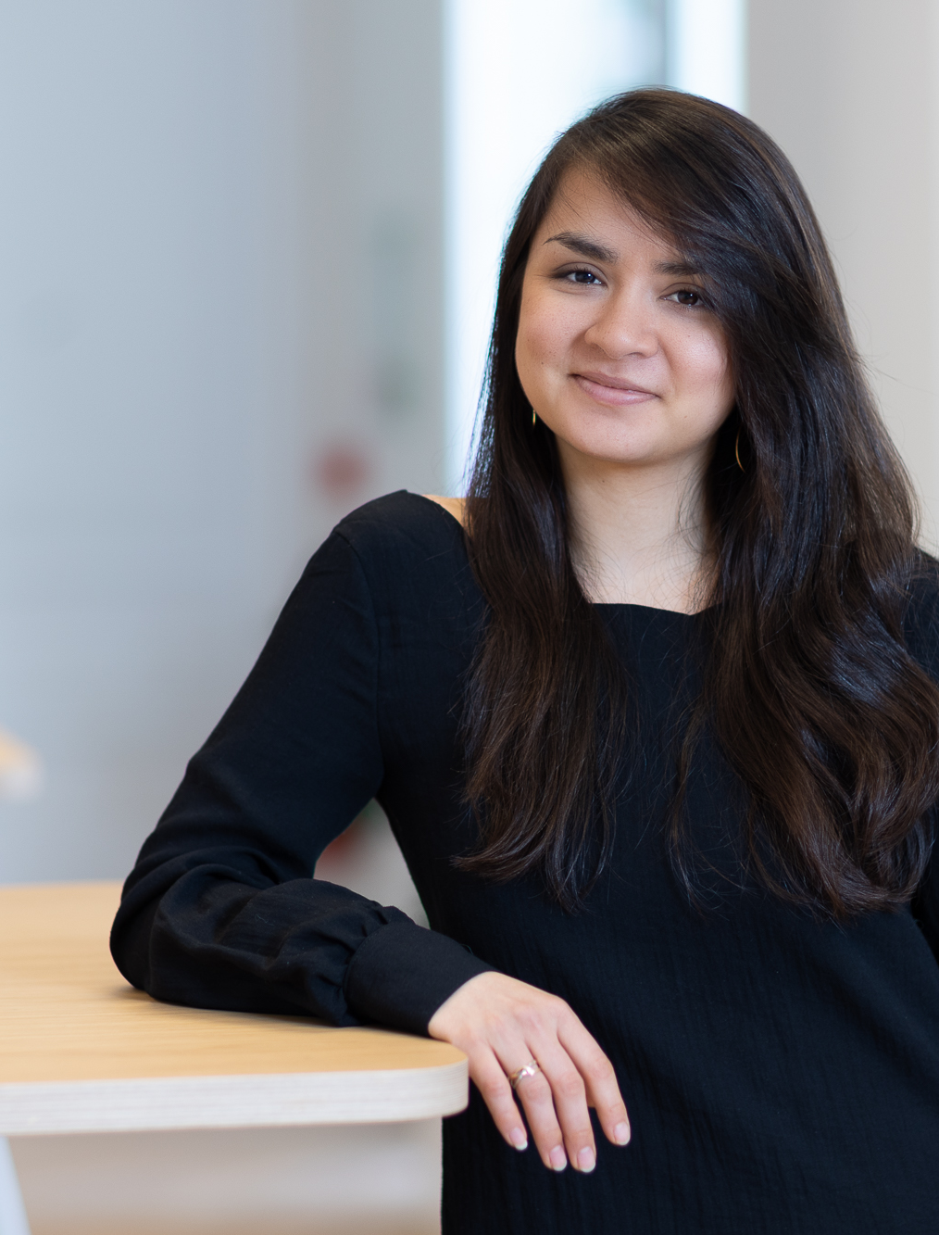
I’ve been working with Questel for 4 years and use their Orbit Startup module to power our own Open innovation platform.
Margaux PLAKSINE
Open Innovation Manager
BNP
#ClientTestimonial

Slide 45
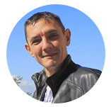
Gérard RENARD
Translator
Bureau Renard SPRL
The first thing I felt when I started working with Questel was the human side of the relationship.
#PartnerSpeaks

Slide 46
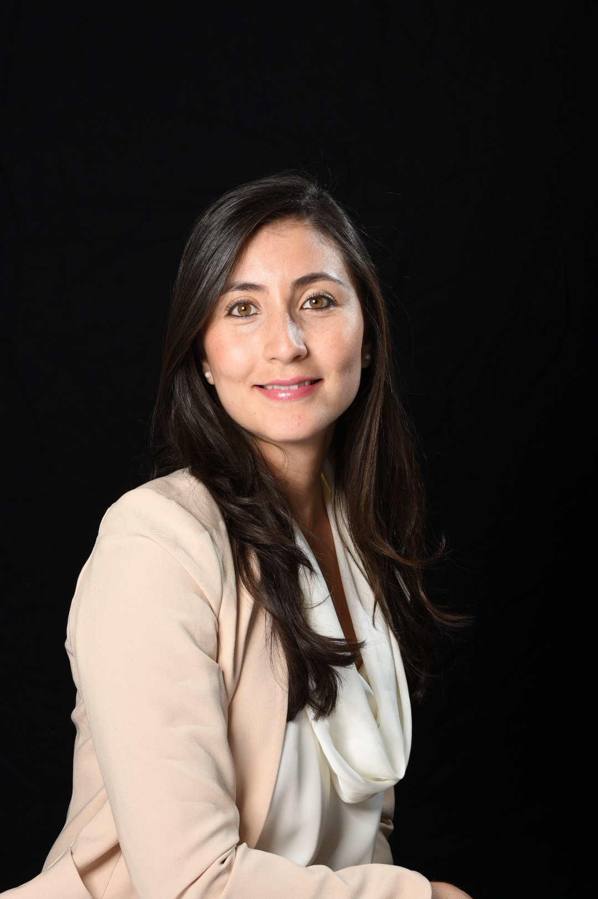

Slide 47
Questel’s participation in social projects helps improve the quality of life of people.
Daniela HOYOS
Help Desk Manager
Questel
#OurTeamSpeaks

Slide 48
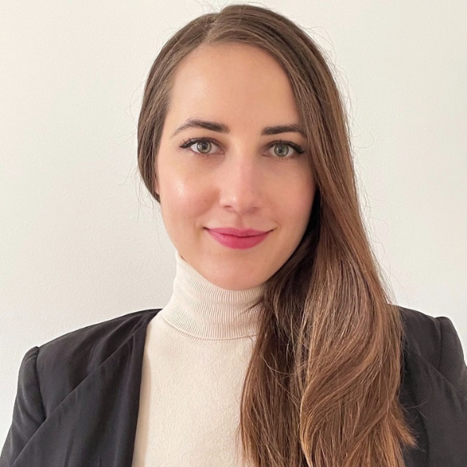

Slide 49
I donated 40cm of my hair to a Cancer Foundation. Questel has shared the project and I hope to inspire other’s!
Giulia MOULY
Manager Inside Sales
Questel
#GiveEmployeesAVoice

Slide 50
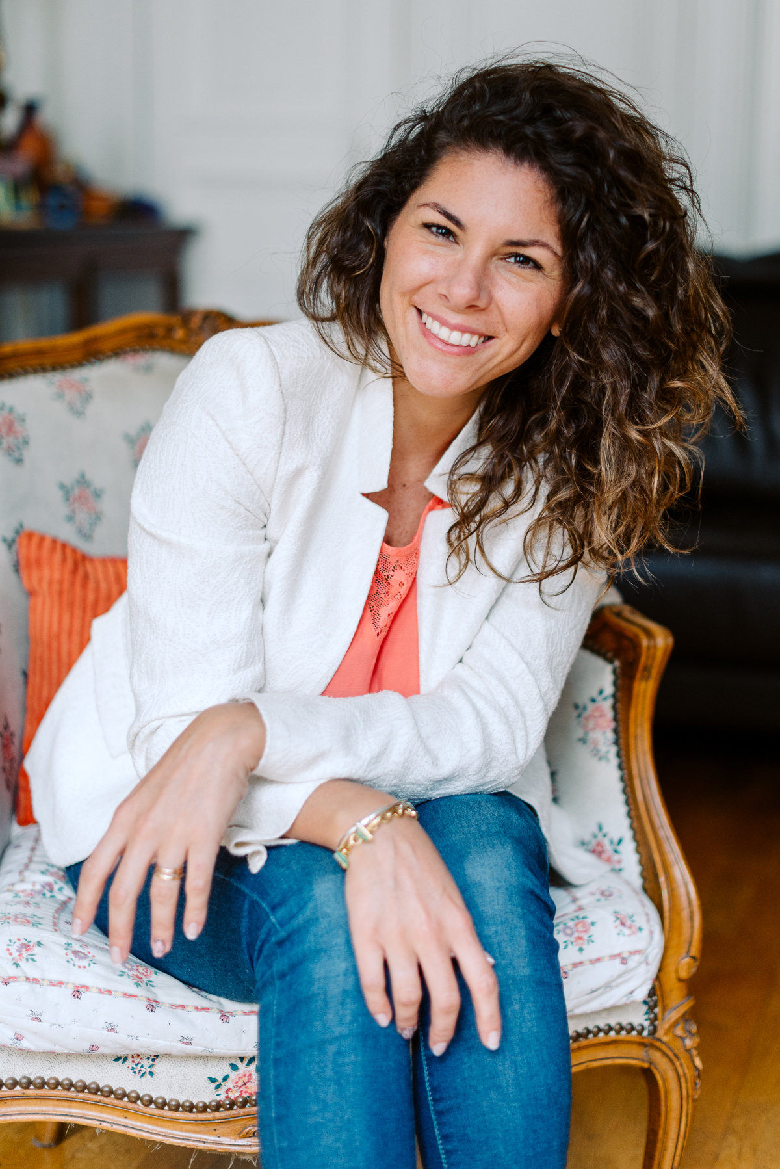

Slide 51
Being involved in social projects is important and investing in education has a huge ROI.
Cecilia SAAVEDRA
Key account Manager
Questel
#EmployeeEngagement

Slide 53
The combination of integrated technology, supportive environment and exceptional relationship with the team has made
all the difference.
Aline COEHLO
QCer Translator, Brazil
Questel
#EmployeeTestimonial

Slide 54
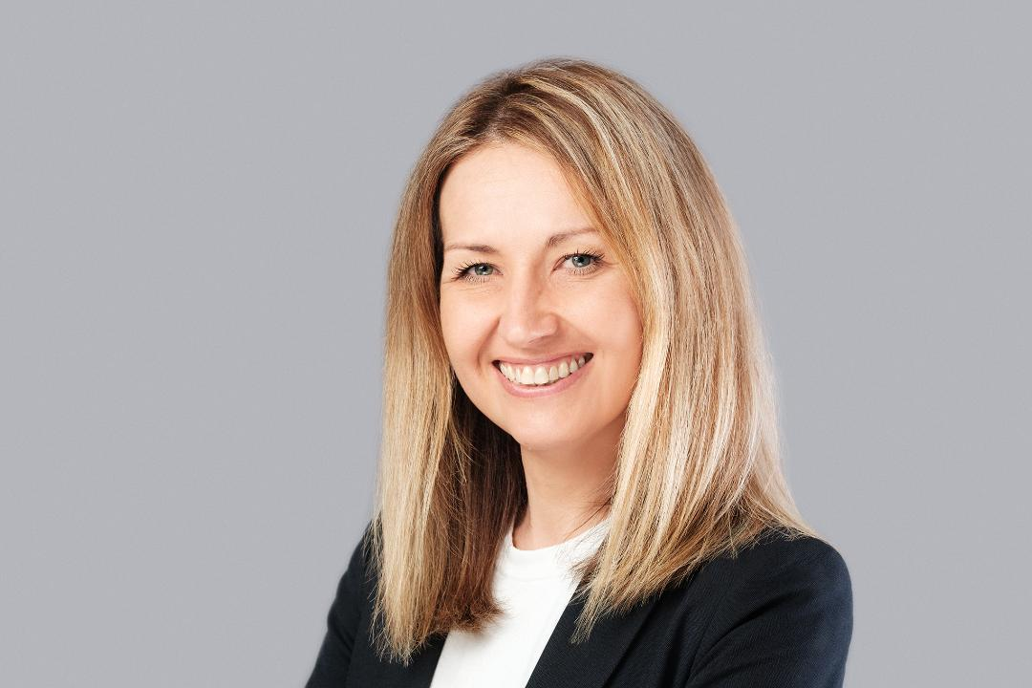

Slide 55
Being a leader is going through adversity and transforming into a positive learning experience.
Anna SIKORA
Group Head of Finance
Questel
#EmpowerWomen

Slide 56
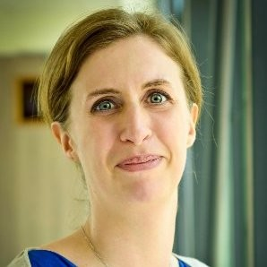
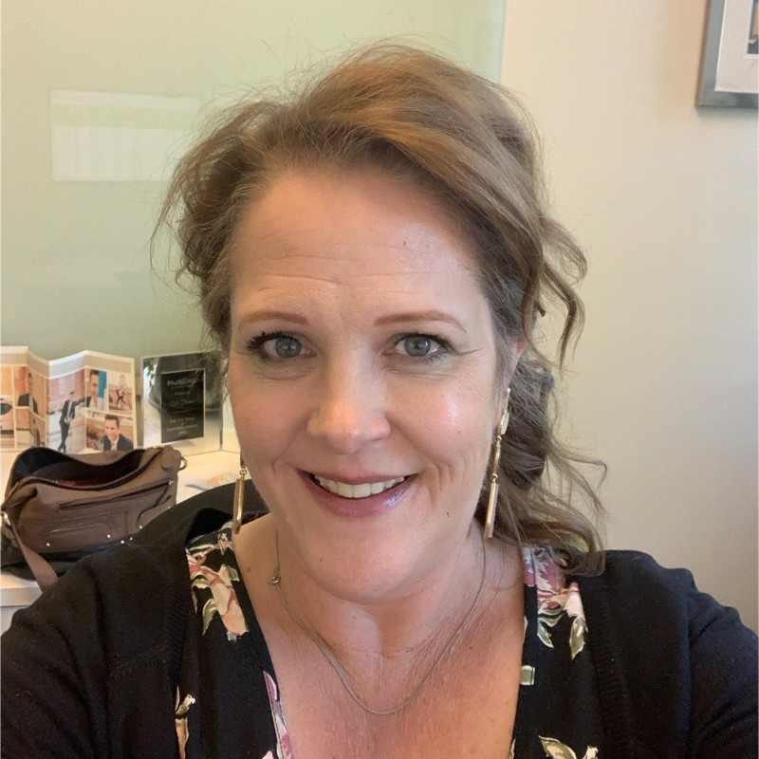
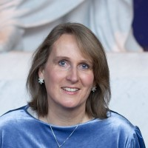
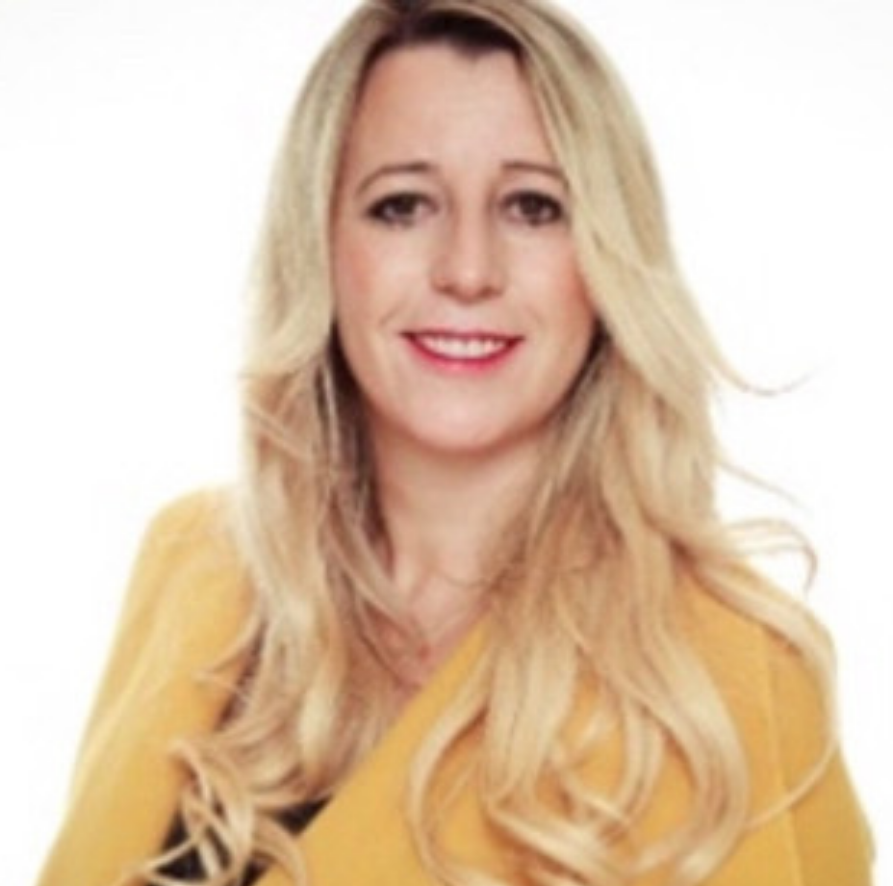
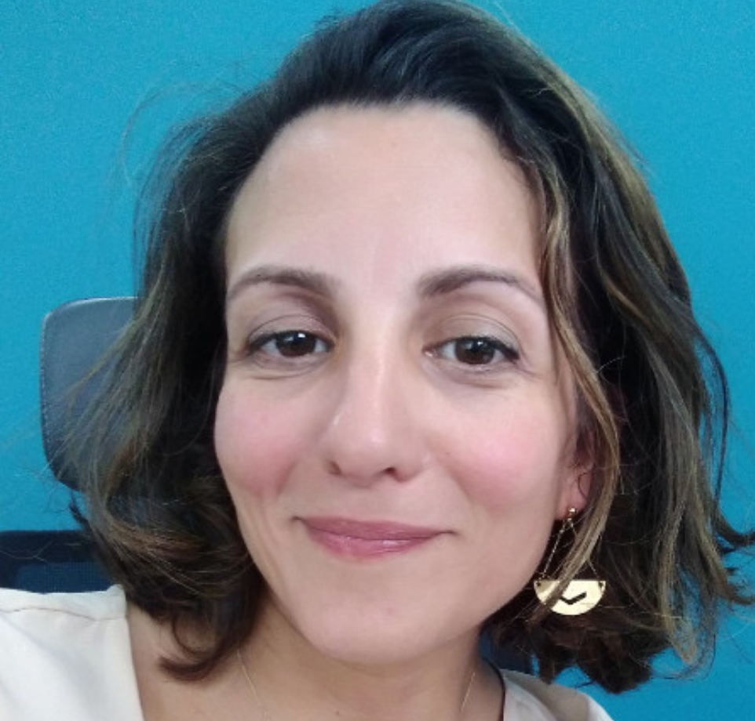
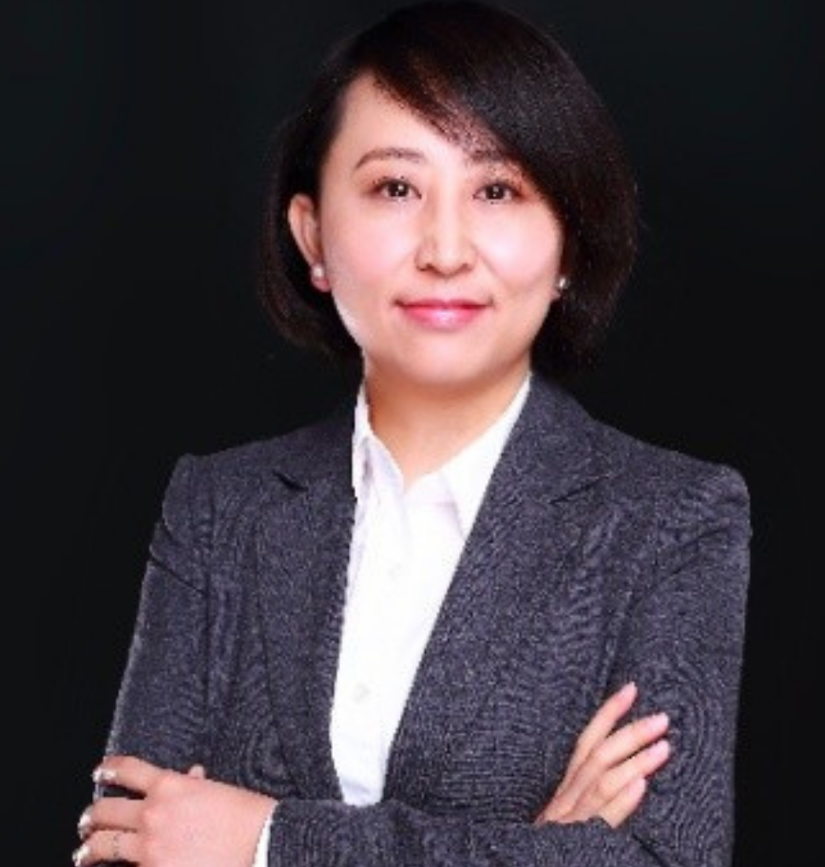
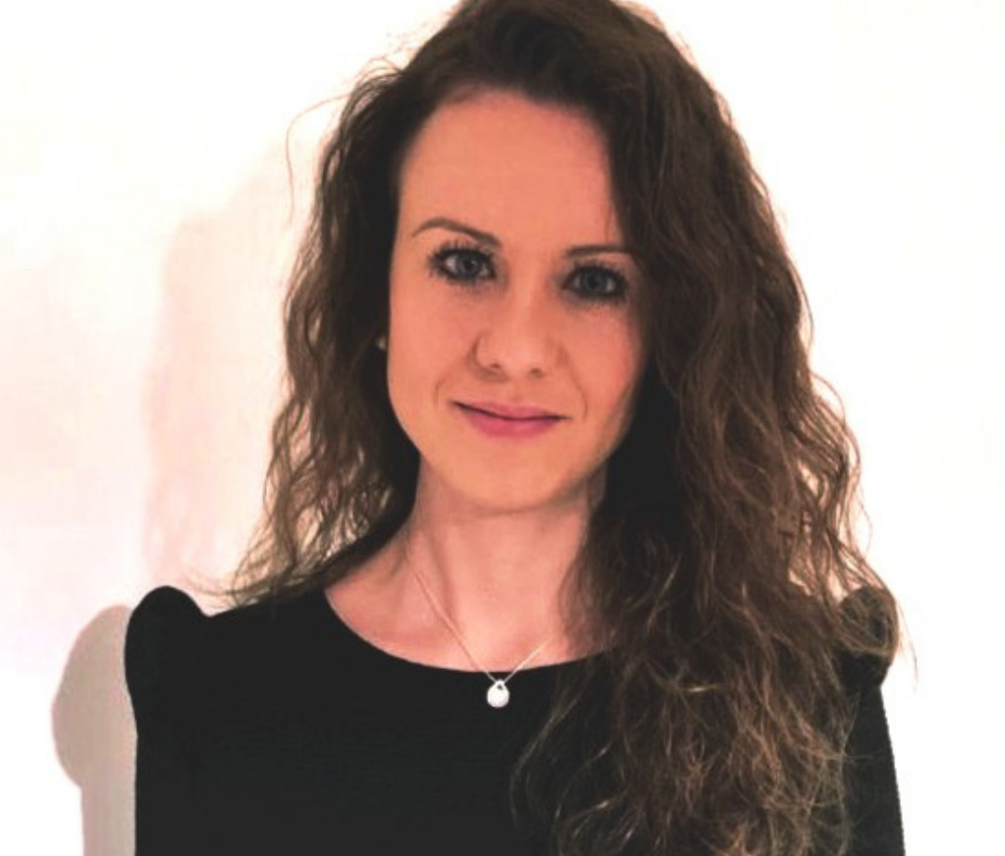
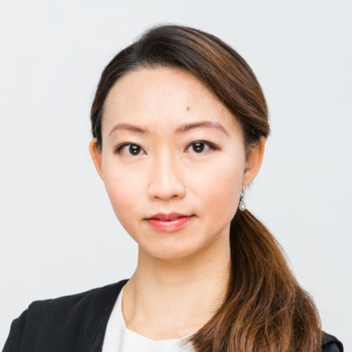
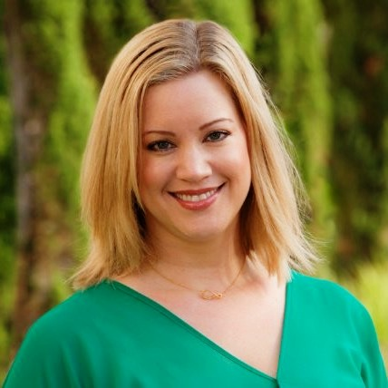
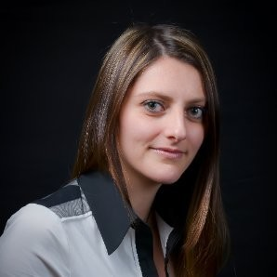
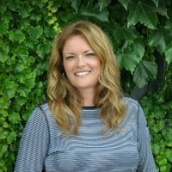
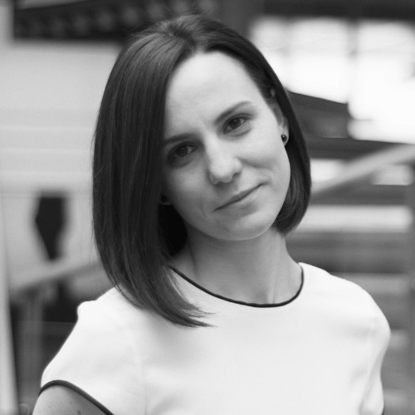
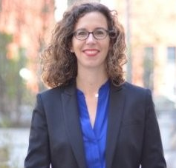

Slide 57
46% of women at
in 2021
#EquityIsAPriority

Slide 58
36% are currently managers
#YouArePowerful

Slide 59
Objectives
for 2025
#CSRGoals

Slide 60
50% women in managers
#EmpoworedWomenEmpowerWomen

Slide 61
Green objectives
for 2025

Slide 62
100% of our offices found hardware sustainable waste solutions
#SustainabilityForABetterFuture

Slide 63
20% of new electronics are reconditioned
#TogetherForABetterWorld

Slide 64
-50%
of internal travel
CO2 emission
per employee
#PolluteLess

Slide 65
50% of offices and servers run on green energy
#GreenIPChallenges

Slide 66
Each year
welcomes interns, trainees & young graduates
#YouthAreTheFuture

Slide 67
Learning and living go hand in hand and the more you learn, the better you live
#KnowledgeIsPower

Slide 68
Our goal is to provide youth with the means to develop their competencies
#BecomeWhoYouAre

Slide 69
Technologies, processes, and
practices designed to
protect networks, devices, programs, and data.
#Cybersecurity

Slide 70
Questel’s team has implemented
security procedures
to protect
the data
#SecuringInformationIsOurResponsability

Slide 71
Employees must take a cyber
risk awareness and data protection
training session
#ImprovementForBetterQuality

